Slide 1
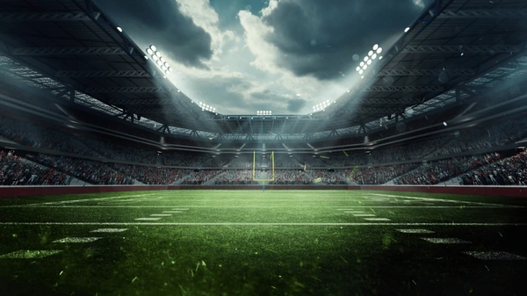
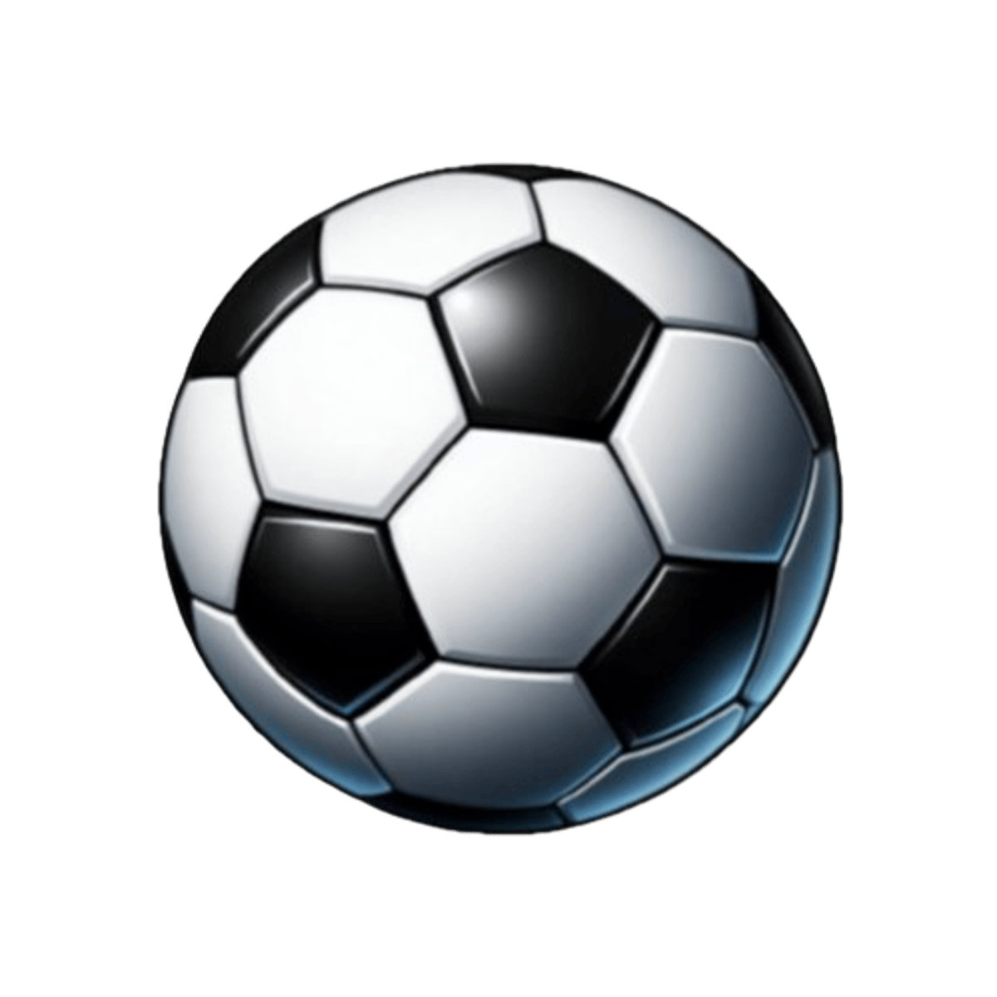
Football
Football rules
The famous tournaments
Football history
Football’s impact on people
Notes:
<Foliennummer>

Slide 2
Football
Football refers to several team ball sports played on a rectangular field with goals at each end, where the objective is to get the ball into the opponent’s goal.
It is a popular game because it is globally accessible and easy to understand, requiring only a ball and open space
Notes:
<Foliennummer>

Slide 3
Football rules
Football rules dictate that two teams of a maximum of eleven players each compete to score goals by getting the ball into the opposing team’s goal. Each match is ninety minutes long, and the players are not allowed to touch the ball with their hands.
Notes:
<Foliennummer>

Slide 4
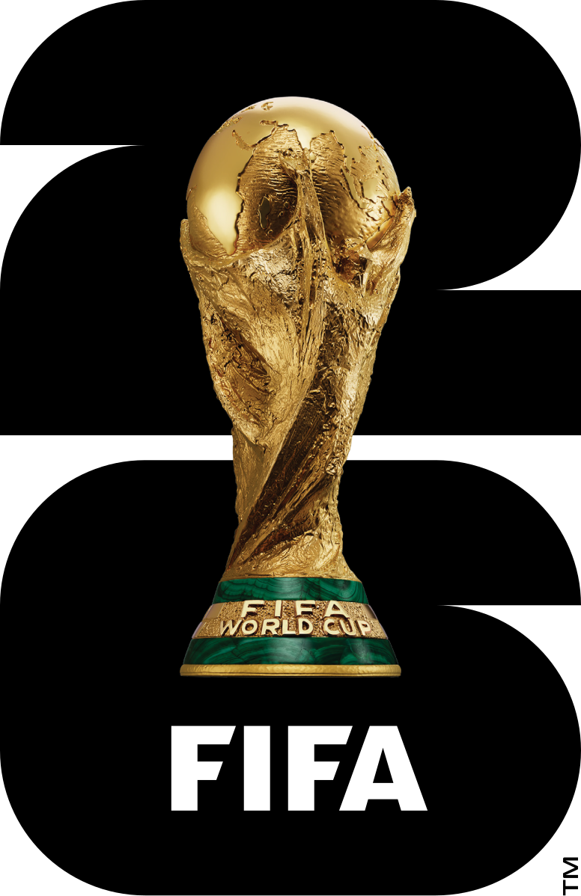
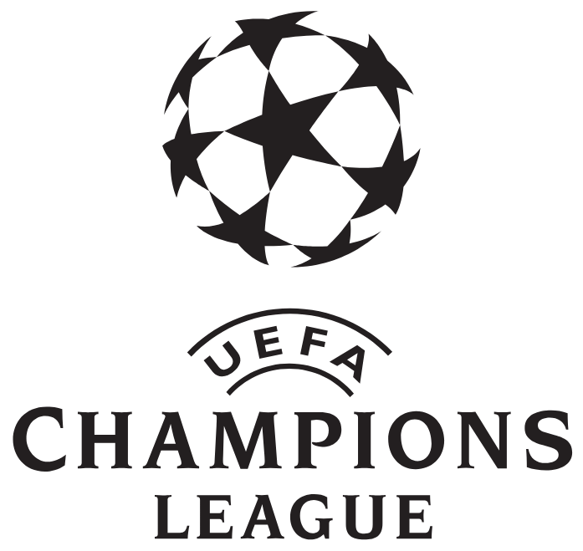
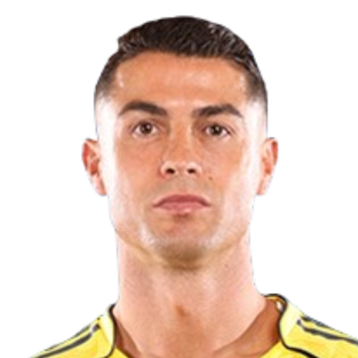
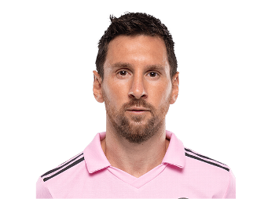
The famous Tournaments
The famous football tournaments are the FIFA world cup, the premier international tournament for national teams, the UEFA Champions Leage.
Some of the famous players are Cristiano Ronaldo, Lionel Messi, Thiery Henry, Zinedine Zidane, Luka Modic, Kylian Mbape.
Notes:
<Foliennummer>

Slide 5
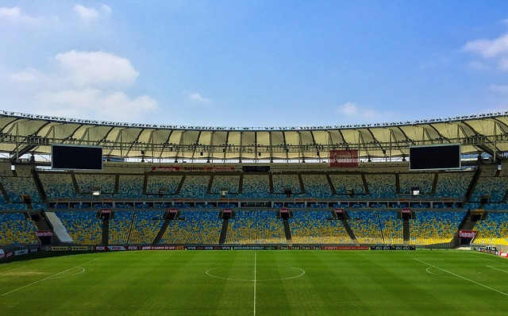
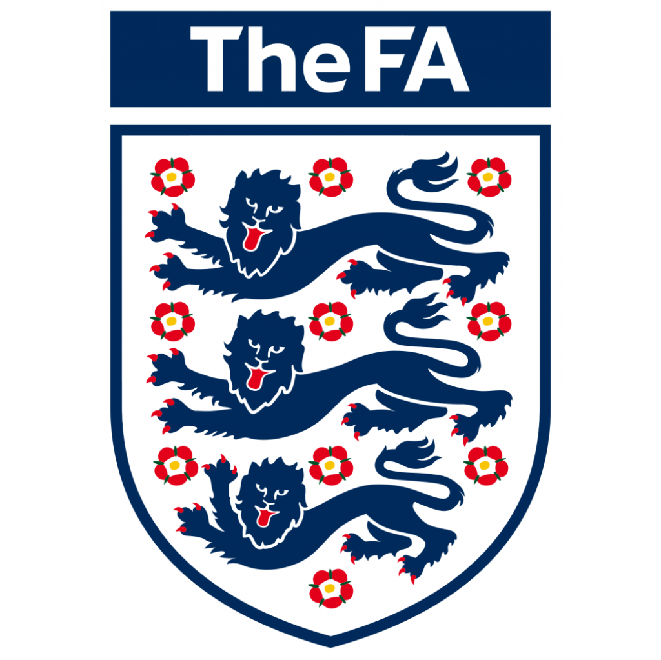

Football history
Football's journey spans thousands of years, evolving from ancient ball games played by early civilizations to the global sport we know today. In ancient China, Greece, and Mesoamerica, people played primitive versions of football, often with different rules. By the Middle Ages, chaotic village games in England paved the way for the formalization of the sport. In 1863, the Football Association (FA) in England standardized rules, officially creating modern football. The sport spread globally, aided by British colonial influence, and in 1904, the FIFA was founded to govern international competitions. The first FIFA World Cup in 1930 marked the beginning of the sport’s global appeal. Today, football is the world's most popular sport, with major tournaments like the World Cup and Champions League captivating billions worldwide.
Notes:
<Foliennummer>

Slide 6
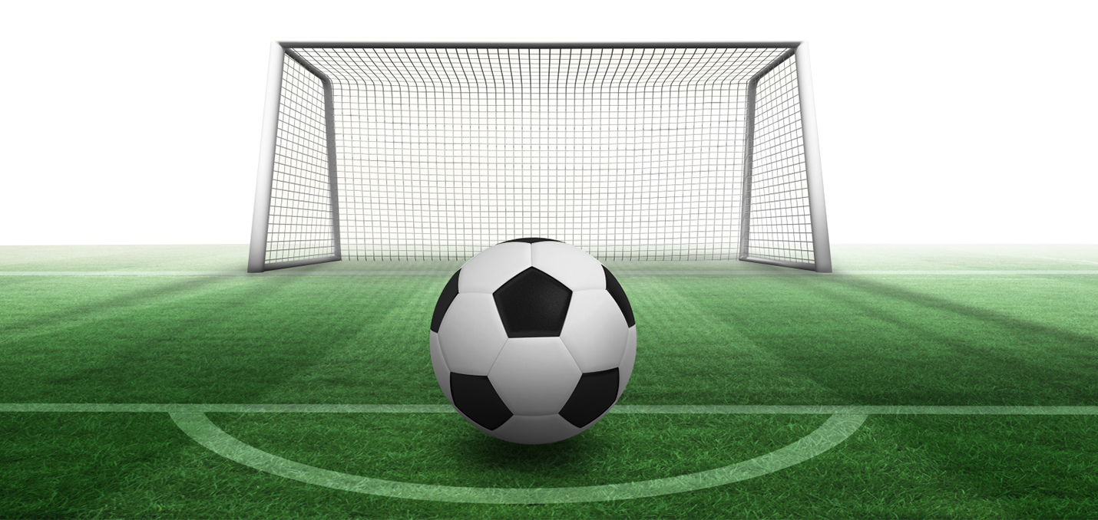
Football’s impact on people
Football significantly impacts people’s physical health by improving cardiovascular fitness, strength and coordination, while also enhancing mental well-being through improved concentration, decision-making and resilience.
Notes:
<Foliennummer>

Slide 7
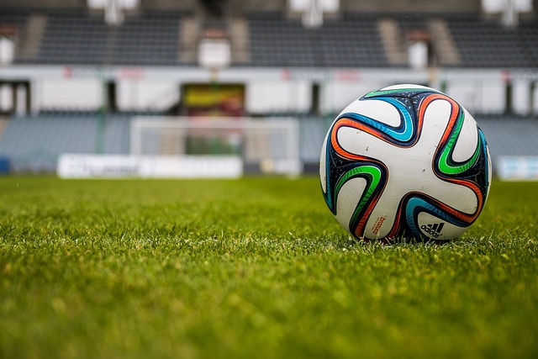
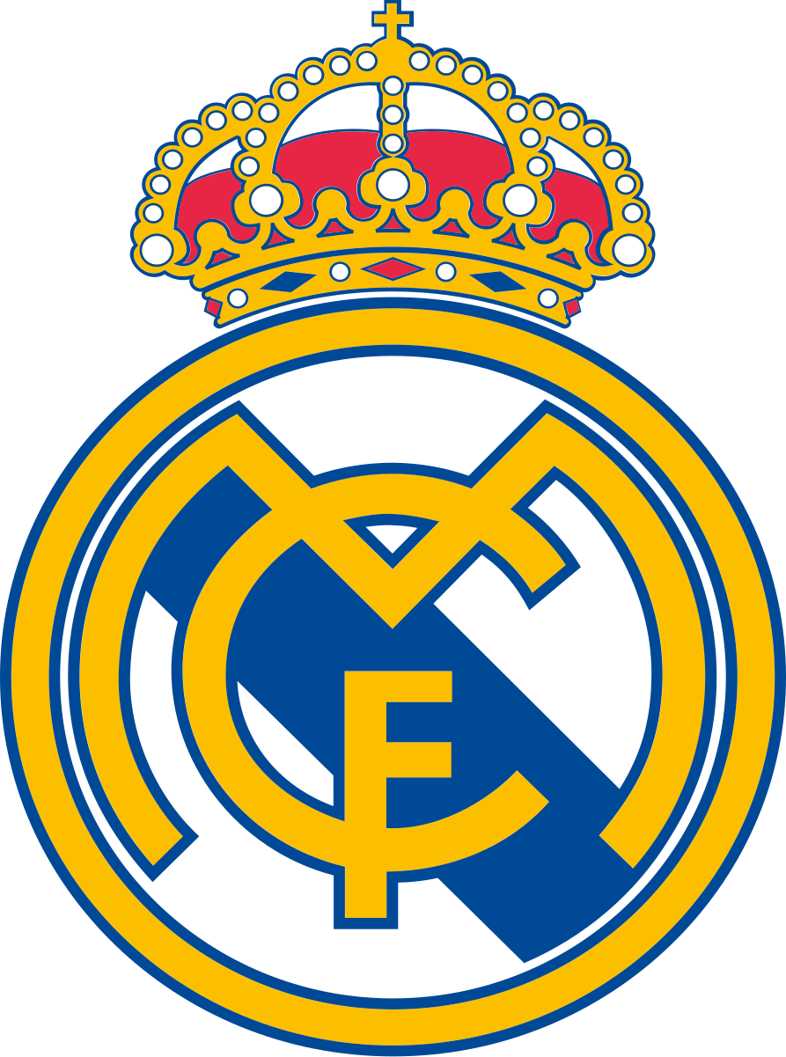
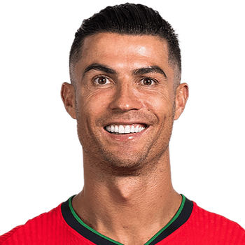
My favorite player and team
My favorite team is Real Madrid, it is a professional football club. From Madrid, Spain, founded in 1902 and known for its all-white kits and the nickname “los Btancos” (the whites). The club, which officially became “Real” (Royal) in 1902, plays at the world’s most successful and widely supported clubs. Real Madrid holds numerous records, including a record 15 UEFA Champions Leage titles and a record 36 La Liga titles.
My favorite football player is Cristiano Ronaldo, he is a Portuguese professional footballer, considered one of the greatest players of all times, who plays as a forward for Saudi club Al-Nassr and captions the Portugal national team. Born in 1985, he is known for his exceptional goal-scoring, speed, and iconic status, has won 5 Ballon d’Or awards and numerous club and international trophies, including the UEFA European Champion ship and multiple UEFA Champions Leage titles.
Notes:
<Foliennummer>

